Slide 1

PROJECT WALKTHROUGH – Customer Churn Management
HARMAN CONNECTED SERVICES
ENABLING A WORLD OF CONNECTED EXPERIENCES
Copyright © 2015 HARMAN. All rights reserved. CONFIDENTIAL AND PROPRIETARY

Slide 2
Customer relationship Analytics
Proactive churn management
Customer: Multinational provider of communications technology and services. The client wanted to keep existing customer base intact.
Solution: Customer churn prediction to enable proactive actions to retain customers by classifying the underlying attributes triggering likely attrition.
Tools/Technology: R, Hive, Impala, Excel
Algorithms: Random Forest, Decision Tree, Bagged Classification And Regression Tree (Cart)
Data Volume: over 6.5 million customers, monthly appending
91% of the time model is able to predict whether a customer will churned out or not. If he is churning out what are the risk level and lead time.

Slide 3
ANALYTICS PROBLEM DEFINITION
Hypothesis:
Input : Customer demographic details, billing history, service records, customer satisfaction ratings.
Output : List of customer likely to churn
Time Frame : Monthly data appended till past two years.

Slide 4
PROCESS FLOW
Business Understanding
Identify business problems
Understanding customer profiles
Identify variations in services opted
Identify previous churned customers
Data Profiling Data Preparation
Merging different datasets
Data conversion
Treating null values
Prepare analytical dataset
Exploratory Data
Analysis
Univariate analysis
Feature Engineering
Feature Selection Techniques
Correlation analysis
Modeling
Predicting Churn
Predicting Churn Likelihood

Slide 5
WHAT HAVE WE ACHIEVED? WITH BIG DATA ANALYTICS
Predict customer likely to churn.
Predict churn likelihood buckets to enable proactive action.
Develop prioritized and actionable recommendations based on churn likelihood bucket.
Highlighting pain areas of customers which are resulting in churn.

Slide 6
PREDICT CUSTOMER CHURN PROBABILITY
ML classifier for predicting customer churn
Predict churners
Output
Customer
Base
1- 0
1
TP : Actual Churners
P1 | P2 | P3
At Risk | At Risk | At Risk
High Risk | High Risk | High Risk
Low Risk | Low Risk | Low Risk
Likely Churners
Active Customers
FP : Actual Non Churners
Inflow
New Customers
0
Key Drivers for probable churners
Likely Non Churners
0
FN : Actual Churners
0
TN : Actual Non Churners
Predict Non Churners
Different churn buckets at different time periods.
1= churn flagged , 0 = Non churners

Slide 7
DATA AND PROCESS CHALLENGES
Data Challenges
Merging different databases , common key identification.
Over 930 variables, leading to variable reduction to improve prediction accuracy.
Data transformation and cleansing.
Prediction Challenges
Longer Prediction window to enable preventive actions.
Telecom challenges
Imputation of missing information.
Pattern detection for churn based on subscription service features
Key drivers for Churn for different buckets.
One customer many connections in select cases.
Multicollinearity in data
Different buckets for prediction for risk assessment.

Slide 8
DATA PREPARATION
Variables / Attributes from Tables 930
Domain briefing
Variables were shortlisted and few were merged as per client briefing. 498 remaining
Identify variables having Missing values variables with Missing value > 20 % were dropped :
295 remaining
Skewed variable : Deleting Variables which are highly skewed :
230 remaining
Correlation Analysis : Excluding variables which have high correlation :
195 remaining
High VIF :
Variables have been excluded due to high VIF ( VIF >5)- :
165 remaining
Variables having Non Significance ODDS Ratio:
126 remaining
Final list of Variables Going into ML Model:-126
Note :Variable number are without Churn flag

Slide 9
LOGISTIC REGRESSION MODELING RESULTS
Model Accuracy : Training data
Lift Chart
Accuracy Measures | Measure(%)
Over all Accuracy | 91
Over all Error Rate | 09
Sensitivity | 87
Specificity | 92
Model detects 91% churn within Top three deciles
Model Accuracy : Test data
Accuracy Measures | Measure(%)
Over all Accuracy | 95
Over all Error Rate | 05
Sensitivity | 92
Specificity | 89
Lift chart : Targeting top 30% of consumers model detects 86% of them as churners.

Slide 10
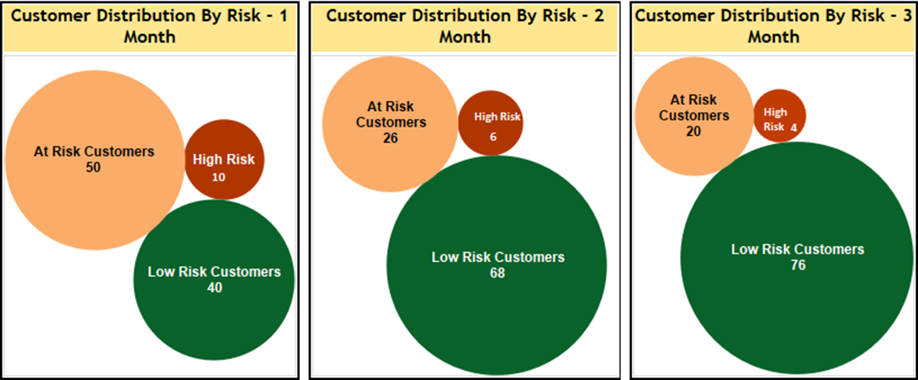
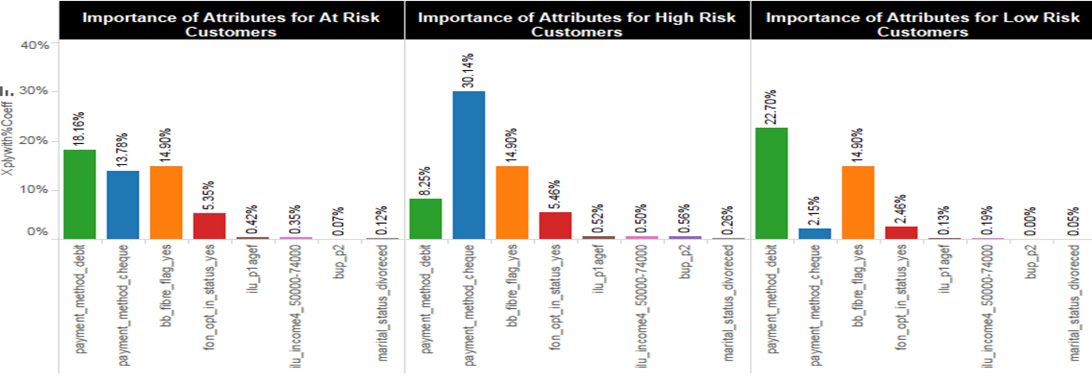
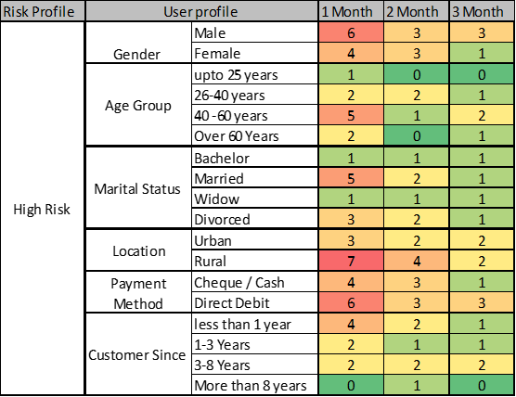
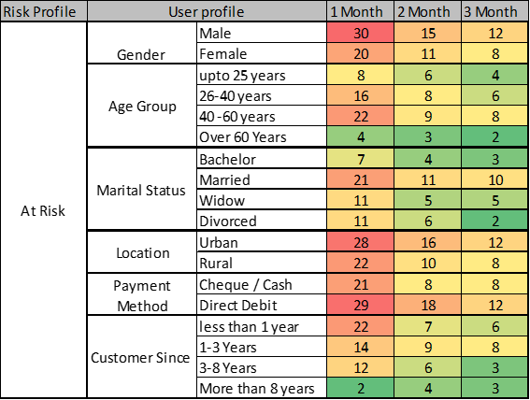
Actionable output

Slide 11


Variables impacting Churn
24
Marital Status : “Divorced’ or ‘Living with partner’
Fiber Flag : Fiber flag is present
Fon Opt In Status : Email id for broadband is same for Phone
Payment Method : ‘Cheque ‘ and ‘Debit-card’.
Income : High income group
Age : Age group 30 – 45
Broadband usage : High broadband usage
Total Revenue : High Revenue
BB Hub Product Class : Select Hub product types customers.
Data Volume –Upload : High usage
Service Tenure : Longer tenure
Propellers of churn
Barriers to churn

Slide 12
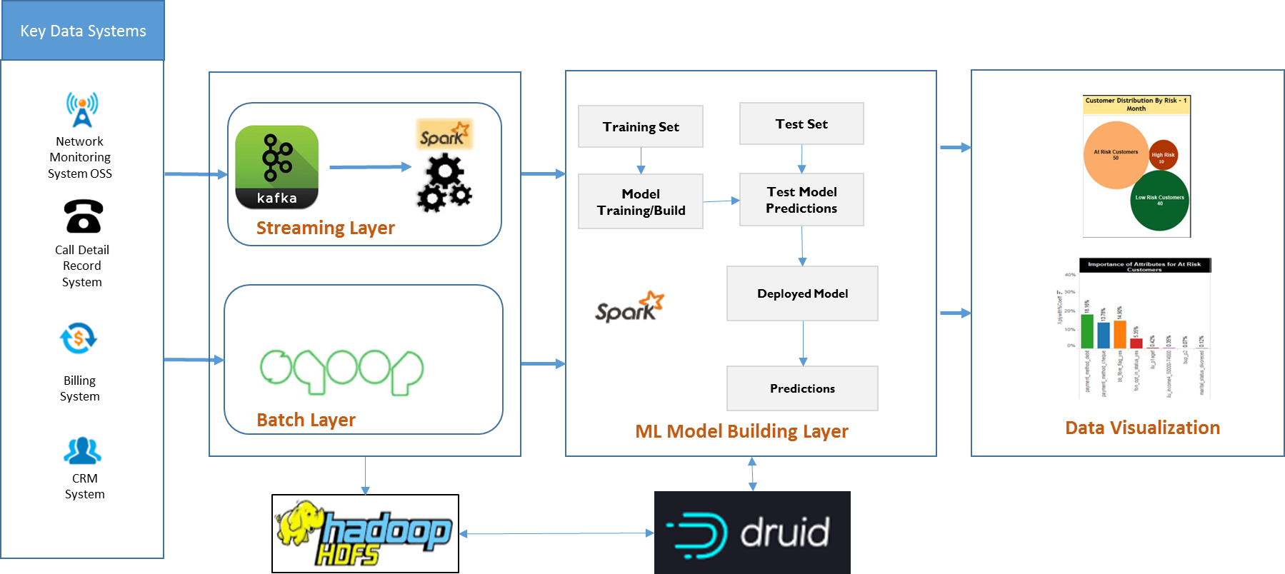
DEPLOYMENT ARCHITECTURE

Slide 13
BUSINESS VALUE
Knowing the propensity scores for customers at risk of attrition, ahead of time, allows for necessary retention actions to be initiated so that the revenue and goodwill impact is minimized; However, by deploying differentiated retention strategies, not only maximizes MROI, but also are very effective in stemming attrition.
Higher Customer
Satisfaction
Quantification of key drivers of relationship identified which enable proactive actions to retain and engage customers.
Increased customer lifetime value by retaining them.
Higher customer engagement.
Actionable – Sort ranking of customers with decreasing churn propensity along with probable time to churn.
Cost effective – differentiated retention strategies can be deployed to improve MROI.
Lower marketing Cost
Improve Brand Image
Higher
Customer
Life
Value
Enriched customer Trust
Loyal Customer Boost Sales

